Slide 1
Fire’s Out
The speed of information saving lives.

Slide 2
O Projeto

Slide 3
Fire’s Out, a project that seeks to accelerate the process of identification and attendance for a fire focus.

Slide 4
Execução
Sensor identifies na emergency;
Verifies the degree of need;
Processes and forwards the data;
Get in touch with the person in charge.

Slide 5
Execution details
1. Sensor makes identification of emergency based on known information of the system, such as:
Sensor models;
Location information;
Avarage of people expectedat the time;
Material that exists in place;
2. The information is forwarded to a central that validates the data already registered in the system;
3. After passing through the validation the information is forwarded to a transmission center, where the emergencywarnings are triggered;

Slide 6
3.1. If the system has access to the internet, it will be made integrated with the system used by the fire brigade team and will trigger a notification information collected by the sensors that sent the warning signal to the;
3.2. If the system does not have internet access, a second contact method will be requested, such as a ready connection or sending na SMS to those reponsible.
Observation:
There will be a difference between emergencies with certainty that there is a fire, using flame sensors, which when triggered should contact directly with department and a second emergency covering sensors that pass warnings of status changes and notify a reponsible person to check.

Slide 7
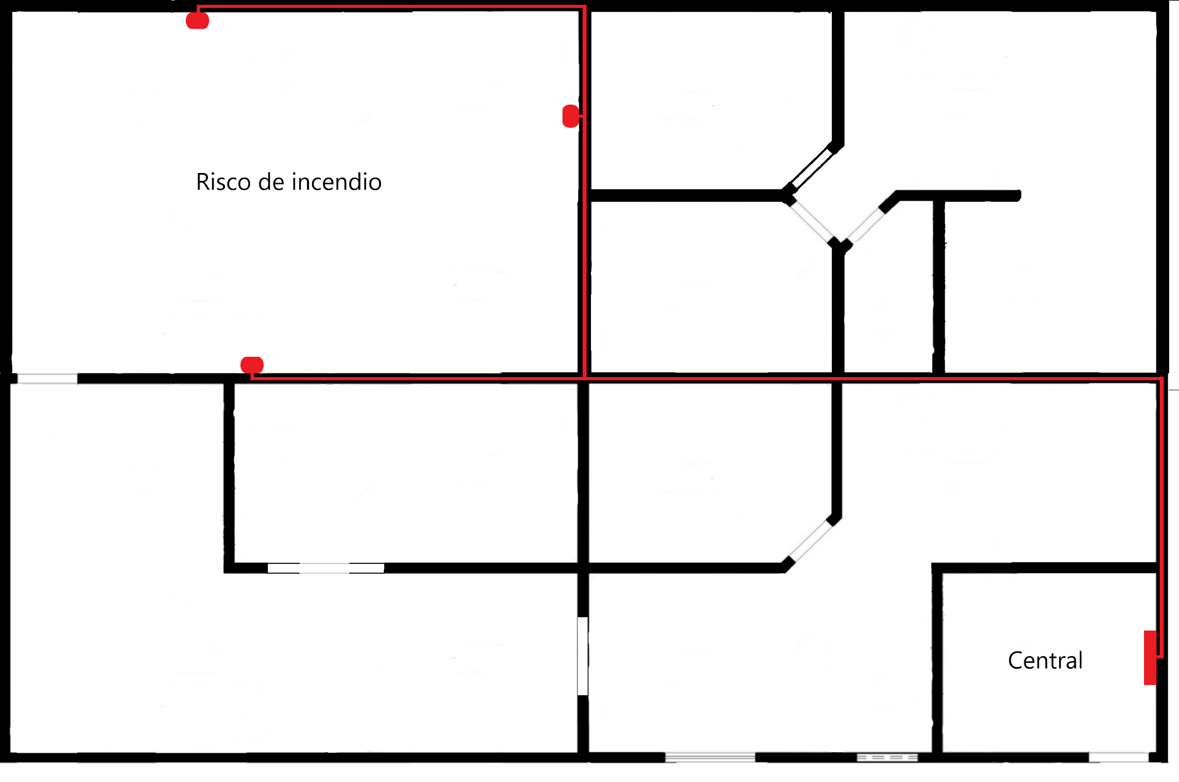
4. From the success with the contact with the fire brigade team, all other damages, procedures and actions will be taken and managed by the fire brigade team itself.

Slide 8


SDG
Ensure a healthy life and promote well-being for all and all, at all ages;
Making cities and humam settlements inclusive, safe, resiliente and sustainable.

Slide 9
We hope that from the warnings launched by the system the agility and efficiency of the fire brigade will be further improved.

